Slide 1
Cyberark Dynamic access provider – DevOps Workshop

Slide 2
agenda
Product Overview
Lab Environment Overview
Securing Jenkins (Labs 1&2)
Securing Kubernetes (Labs 3&4)
Secretless Deployment in Kuberenets (Lab5)
Notes:
If your’re

Slide 3

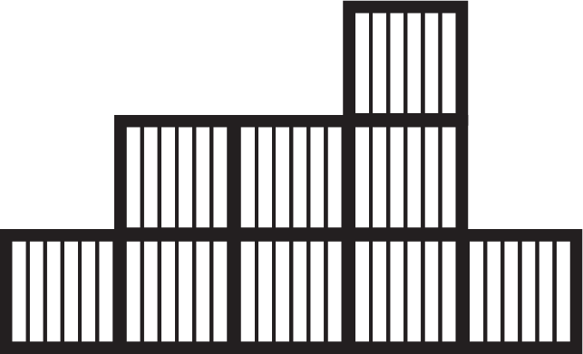







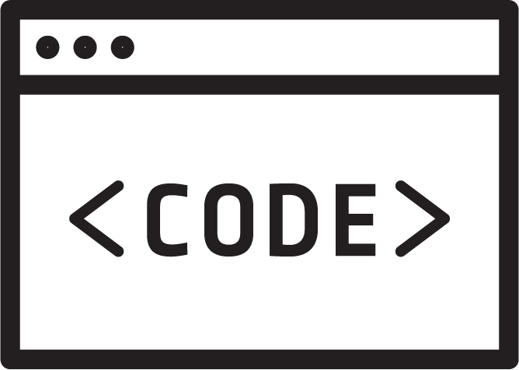








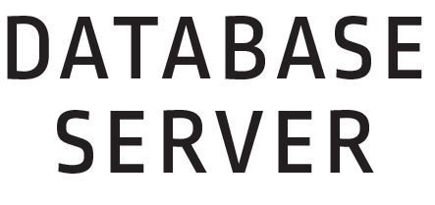







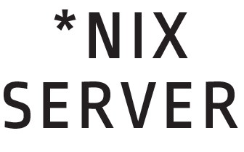



Applications in the Digital transformation
Code is the new privileged user
More Infrastructure
More Applications
More Privileged Actors
More Automation
IT Admins, End Users, Privileged Business Users, SaaS Admins, DevOps Teams
Notes:
So my area of interest is privileged system management from a security perspective. So what does the DevOps landscape look like from a privilege perspective. We are truly looking at a web of interconnected services, users, and highly privileged systems. "Code is the new privileged user"- what do I mean by that. Well Security teams used to look at the human user as the point that they could control the security risk. If I could teach you, train you, watch and monitor you, I could understand my security issues and remediate. Not so much anymore.
Now a series of tools, codes, and scripts and their associated plugins are all at work doing jobs that we used to ask people to control, such as build and release engineering, production system patching and maintenance.

Slide 4


HYBRID ADDS NEW THREAT MODELS & EXPANDS ATTACK SURFACE
The Expanded Attack Surface
More Infrastructure
More Applications
More Privileged Actors
More Automation
More Privileged Security Risk
IT Admins, End Users, Privileged Business Users, SaaS Admins, DevOps Teams
Notes:
And now the "privleged threat surface looks like this: all of these means more privileged security risk. So in just doing the simple analysis of keys and access controls you can start to enumerate all the points of attack. You enumerate who or what has access and then you can start to remediate issues.
Another form of speed bump that we see in DevOps environments is that the "one devops person" essentially becomes a human controller of the risk. This situation leaves you in no better position because that too is a single point of failure and an anti-patterns.
The goal is to make sure that no matter their infrastructure or application architecture that if the security objective is to reduce the threat surface posed by key sprawl, access or overprilege then that goal is met completely, and improved continuously. And that cannot come at the expense of supporting appropriate architectural design choices of the new infrastructure. It is ultimately that application that needs to be served by security.

Slide 5


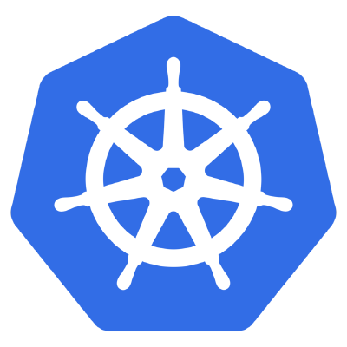



Attackers target Non-human credentials
Tesla Cloud Account Data Breach
Attackers used credentials stored in Kubernetes to hijack cloud resources to mine cryptocurrency
Kubernetes is configured to not require a password for console access
DevOps engineer places AWS access keys in Kubernetes
Attacker finds unprotected Kubernetes console and copies the keys
Attacker uses keys to install cryptocurrency mining software in cloud
Notes:
(Tesla breach)
An unsecured Kubernetes container management console allowed cyber-attackers to breach a Tesla cloud account that contained sensitive data, including telemetry data from the company’s electric cars.
the Tesla breach resulted from the exposure of Amazon Web Services security credentials after hackers penetrated Tesla’s Kubernetes console, which was not password protected This led to the exposure of the company’s Amazon S3 cloud account, which contained sensitive data including the Tesla vehicle telemetry.
The breach also provided access to Tesla’s AWS compute services, which the hackers used to mine crypto-currency.

Slide 6
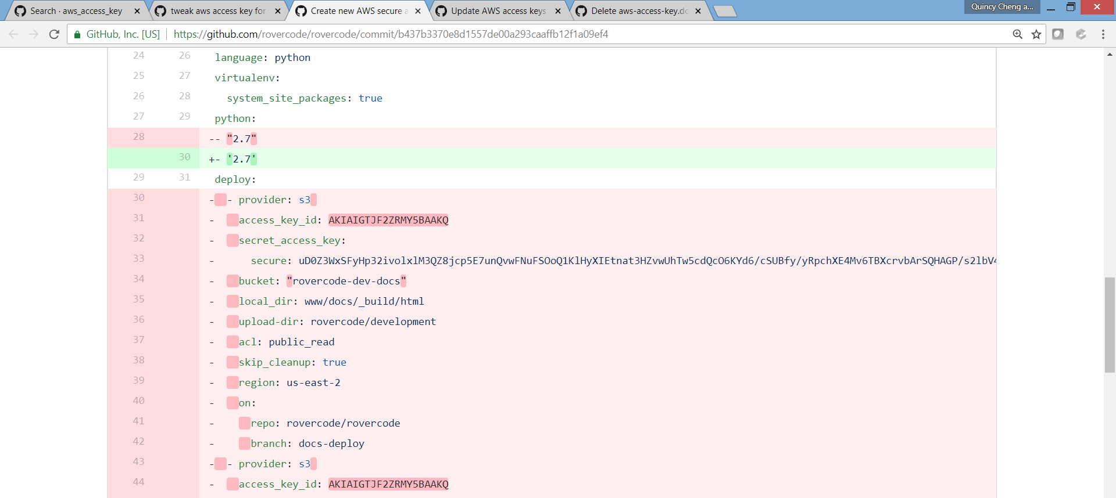
The Problem: embedded secrets

Slide 7
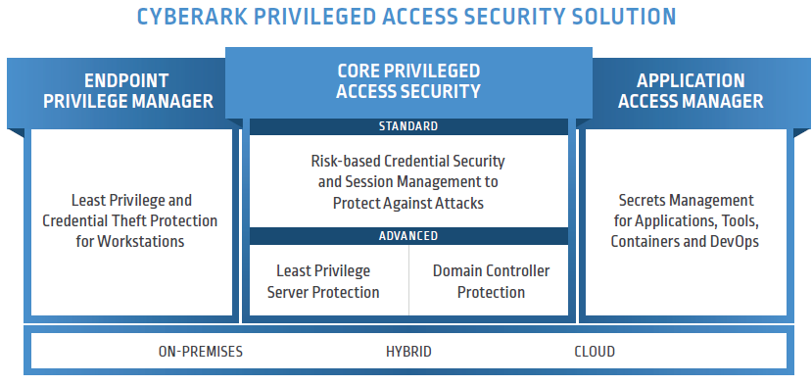
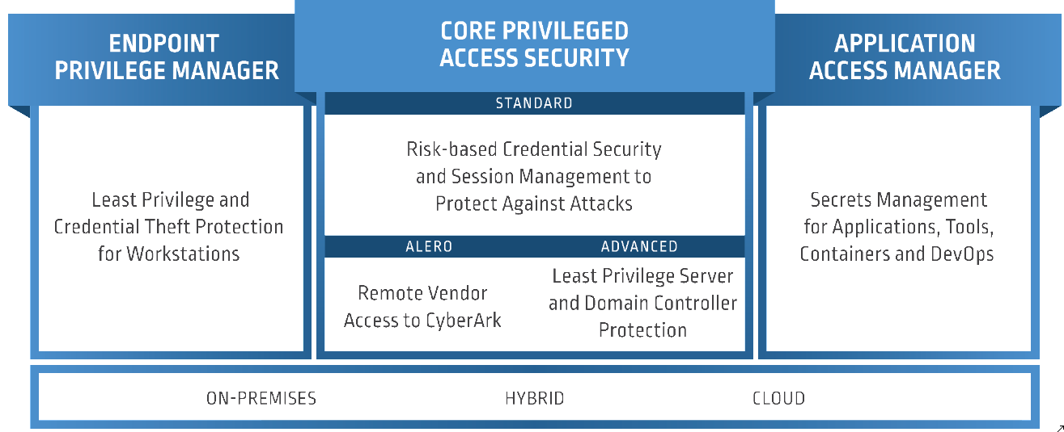
DevOps and Application Secrets Management Portfolio
CyberArk Application Access Manager
Protects non-human privileged accounts
Leverages C³ partner integrations
Integrates natively with Application Servers such as Jboss, WebLogic, Tomcat
Secures DevOps tool chains and PaaS (Kubernetes, OpenShift, PCF, CF)
Offers Open source and enterprise versions
Application Access Manager
Conjur Open Source
From Mainframe to Cloud and CI/CD
Secrets management for static and dynamic environments - DevOps & Cloud
Open Source version
for developers
Notes:
Application Access Manager is designed to secure applications.

Slide 8





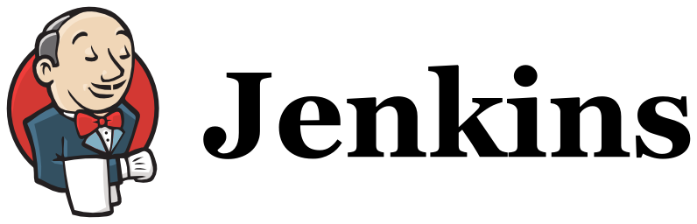

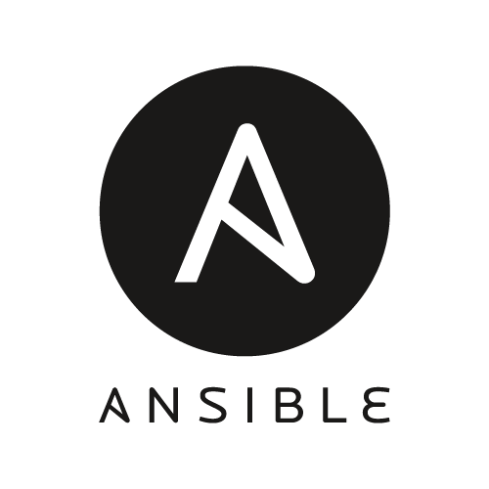
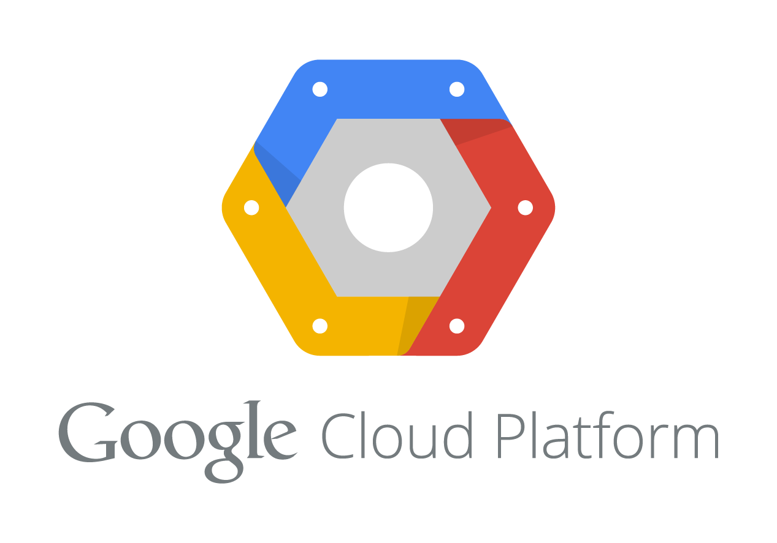
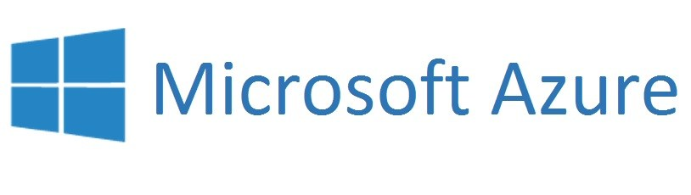
APPLICATION ACCESS MANAGER’S DYNAMIC ACCESS PROVIDER
Addresses the secrets management and privileged access challenges of containers and the CI/CD pipeline
Native integrations avoid impacting developer velocity
Leading container platforms
DevOps tools
Cloud management solutions
Powerful security features improve overall security
Separation of Duties, Role Based Access, Policy based workflows
Vault integration enables policies to be consistency applied
Open Source and “as code” appeals to developers
Easily upgraded to fully supported enterprise version
“as code” enables version control, automated replication, etc.
Notes:
Let’s look at some of the core Conjur capabilities. Conjur was designed to address the unique privileged access security and secrets management challenges of the DevOps pipeline. It natively integrates with many of the cloud management platforms and DevOps orchestration solutions.

Slide 9


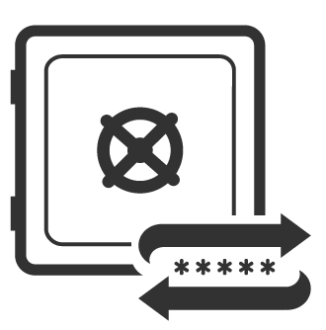
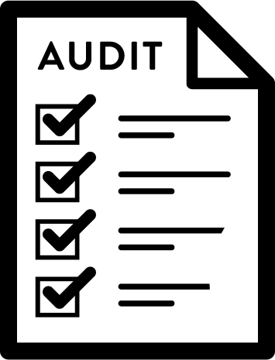



How does Application Access Manager Reduce Risk?
Removal of Hard-Coded Credentials
Establish Identity
to Applications
Credential
Rotation
Limits Discovery &
Reduces Attack Surface
Create Auditable Identity for Apps
Regularly Perform Secrets Rotation
APP ID
Enables Compliance with Audit &
Best Practices
Access is Authorized, Logged and Auditable
No Updates to Files, Code or DBs when Secrets Rotated
Removes Security Island Dilemma
Enforce Multi-Factor Auth for Apps
No Application Downtime Required to Rotate Secrets
MFA
Notes:
Removal of Hard-Coded Credentials
Limits discoverability of application credentials thereby reducing the attack surface
Enables compliance with security best practices of secure secrets storage and use of stronger more complex credentials
Removes security island dilemma by enforcing centralized credential store
Credential Rotation
Password changes can now be performed regularly to comply with security best practices and audit requirements
Configuration files, app code, or database tables no longer need to be updated with new values
Application restarts (i.e. downtime) are not required to rotate credentials
Establish Identity to Apps
Creates an auditable identity to applications (homegrown and 3rd party commercial software)
Increases auditability as now any access to the credential is authorized and logged
Provides ability to enforce multi-factor authentication to applications

Slide 10

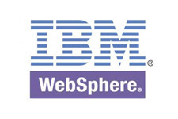







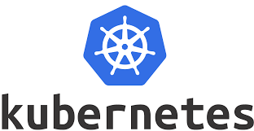
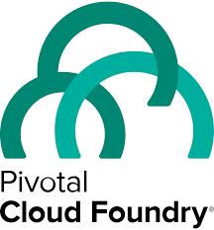












Application Access Manager to Secure Applications
Application Examples
Type | System
Application Servers
CI/CD Tools Chains
Container Platforms /PaaS
SDKs & Dev. Libraries | Go, Java, Ruby, Python .NET, C/C++, CLI, REST
Multiple Platforms | Windows, *nix, zOS, Cloud
RPA
Security Tools
Other Third Party Applications | C3 alliance partners solution with built in AAM integration
Enterprise Resources
AFTER:
UserName = GetUserName()
Password = GetPassword()
Host = GetHost()
ConnectDatabase(Host, UserName, Password)
Servers
Cloud /PaaS
Databases
Applications
BEFORE:
UserName = “app”
Password = “y7qeF$1”
Host = “10.10.3.56”
ConnectDatabase(Host, UserName, Password)
Network Devices
Security Appliances
Eliminates risk from hard-coded application credentials
Leverage flexible deployment options to meet the security and availability requirements of a wide range of applications
Websites/ Web Apps
Cloud Infrastructure
Notes:
Here’s a simple example of an application using credentials to access enterprise resources
<Click>
In the “Before” scenario the credentials are hardcoded, and visible to anyone with access to the application code
<Click>
In the “After” scenario an API call is used to access the secrets. Note the credentials are stored in the vault and managed
<Click>
This approach
Eliminates risk from hard-coded application credentials
Leverages flexible deployment options to meet the security and availability requirements of a wide range of applications

Slide 11



High-Performance High-Availability Architecture
High availability and High Performance – no down time
Followers run near the applications/containers/tools and provides local cache
Credential Providers are installed near the applications and provides local cache
Synchroous and Asynchronous standby cluster
Elastic scalability
Container architecture of followers enables auto scale
Robust password change options
Dual accounts for maximum resiliancy for all AAM solutions
Load Balanced Followers
Standby
Master
Asynchronous
Master
Standby
Master
Synchronous
Notes:
DevOps and Robotic Process Automation (RPA) need super power credentials to perform their tasks
There are a number of challenges when it comes to securing application credentials.
They exist everywhere – in servers, databases, network devices, scripts, etc. We’ll dig into this more on the next slide. And, because they exist everywhere, there are a large number of them throughout the IT environment. Typically, we’ve seen that there are approximately 3 to 4 times the number of privileged accounts as employees.
Hard-coded – for ease of use, application credentials often come hard-coded and embedded in the code or script – and sometimes in clear text. This represents a significant security vulnerability because attackers or malicious insiders could easily obtain access to these application credentials. In addition, when credentials are hard-coded and/or locally stored such as SSH keys, they are nearly impossible to rotate, further making them an static and easy target for attackers.
They are stored locally – Application credentials are often unmanaged, locally stored SSH keys which can easily be compromised, copied, moved, etc.
They lack accountability – when application credentials are hard-coded and embedded in scripts, it’s difficult to track who or what has access to them and what they are doing with that access. With no central management of these credentials, there is no way to track or assign accountability to application credential use.
Last but not least, because application credentials provide access to mission critical systems, attackers are often pursuing these credentials. We’ve seen it in a number of recent breaches that have hit the headlines.

Slide 12
DAP Reference Architecture – production Example
Enterprise Vault
Synchronizer
DR
DC
S
M
S
Async
Sync
LB w/ Health check
Cloud
OpenShift
/ k8s
F
F
F
F
LB
LB
CI-CD Tools / Applications
CI-CD Tools / Applications

Slide 13
Today’s lab environment
Enterprise Vault
Synchronizer
M
J
OpenShift
/ k8s
F
APP1
APP 2

Slide 14
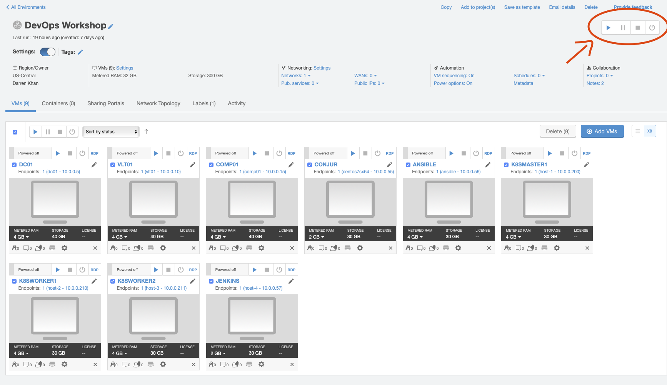
Skytap environment
Hosted cloud platform
Unique environment per attendee. Please don’t share your links and/or passwords!
How to start your environments!

Slide 15
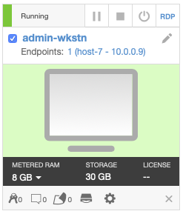
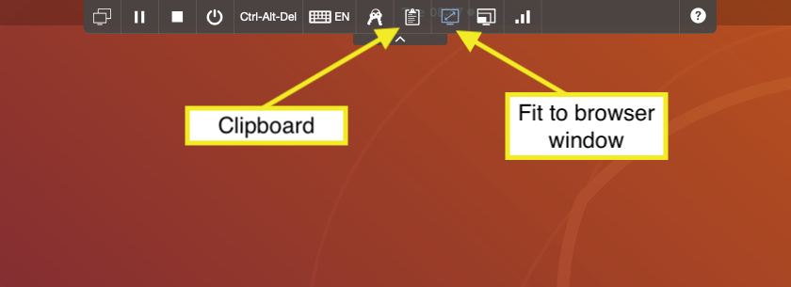
Admin-wkstn
Click on “admin-wkstn” to get to the desktop

Slide 16
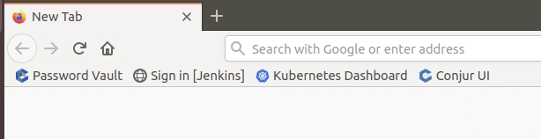
Accessing the rest of the lab environment
Launch ”FireFox”
Accept any certificate warnings by clicking “Advanced…” and then “Accept the risk and continue” if prompted
Shortcuts for the rest of the lab environment

Slide 17
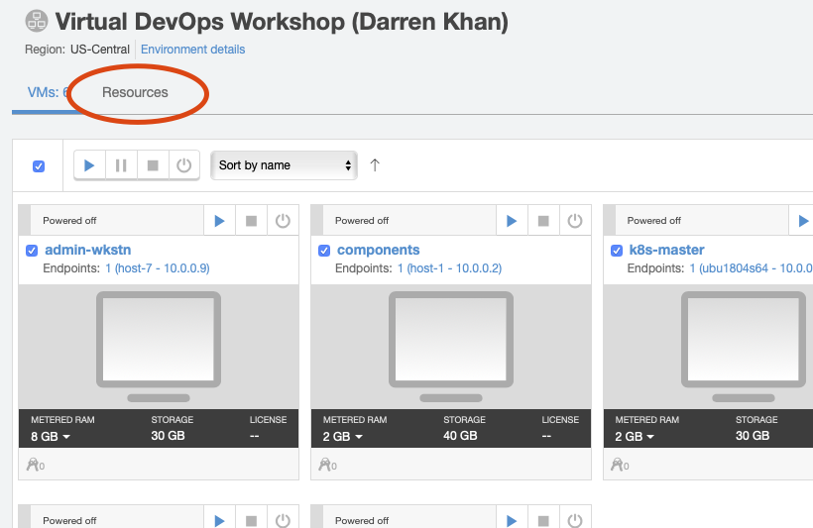
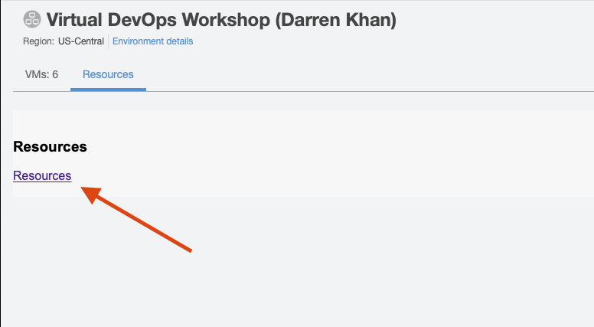
Workshop guide
The workshop guide has all detailed information about the lab environment.
Please make sure to read each section of the guide when following the labs.
Guide is available as a PDF on the “Resources” tab in SkyTap.

Slide 18
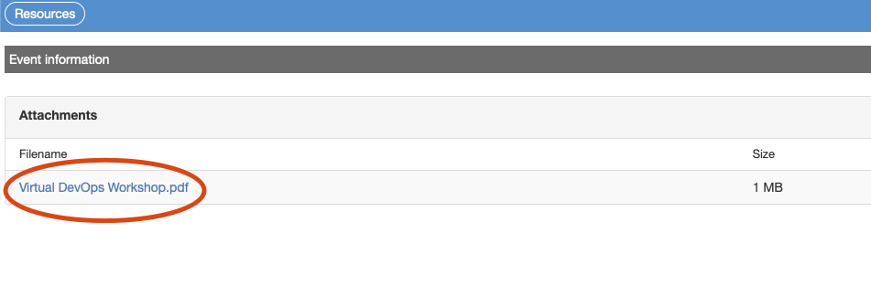
Workshop Guide cont.
Click on PDF link to download a copy.

Slide 19
Session format
Attendees will then be assigned to a breakout session
CyberArk instructors will be available in each session
Please join the audio in the breakout session

Slide 20
LAB 1

Slide 21

Lab 1 - Jenkins FreeStyle Project
Jenkins job has been configured with credentials using the Jenkins credential store.
Credential will be rotated and job will fail.
DAP will be configured to allow Jenkins to access a secret
Job will be re-configured to use DAP instead of a hardcoded credential.

Slide 22
LAB 2

Slide 23
Lab 2 - Jenkins Pipeline Project
Create credentials in Jenkins that reference DAP objects.
Create Jenkins pipeline project.

Slide 24
LAB 3

Slide 25


kubernetes – Conjur Detailed Flow
Create a policy for each pod/ application
Load the policy into Conjur Master
When pod starts, Conjur-authn-client goes up and creates a CSR
Conjur-authn-client calls the Follower with pod details and CSR
Follower verifies pod exists against Kubernetes API
If exist, signs the request and writes it out of band to the Conjur-authn-client
Conjur-authn-client calls Follower - follower authenticates against Conjur policies and returns a encrypted token
The Conjur-authn-client decrypts the token and writes it in the pod shared memory
Summon uses the token to fetch the secrets from Conjur and writes the retrieved secrets to the environment variables.
Application Project
Init Container
Pod
Conjur-authn-client
Conjur Master
Shared Volume
Summon
App Container
Pod
Conjur Follower
(and authenticator)
Pod
Init Container
Conjur-authn-client
Load Balancer
Pod
Shared Volume
Conjur Follower
(and authenticator)
App policy:​
​
- !policy​
id: allowed_apps​
annotations:​
description: Apps and services in cluster.​
body:​
- !layer​
​
- &apps​ ​
- !host [namespace]/service_account/[sa-name]​ ​
- !grant​
role: !layer​
members: *apps​
Summon
App Container
Conjur Project
Notes:
Summon wraps the app container - this is not an extra process.
Only one process.
Summon is not a must here and is used to provide a better and more native solution.
Instead, one can use the SDKs or REST APIs.
For rotations – one can either spin down and up his pods, or use SDK directly instead of summon to support the rotation.
The access token is valid only for 7 minutes. Every 5-7 minutes the authentication process is running and creating a new access token.

Slide 26
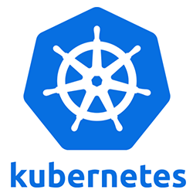
Lab 3 - Kubernetes secrets provider
Useful for already existing applications utilizing Kubernetes secrets.
Deploy a k8s native application.
Deploy DAP follower
Deploy app integrated with DAP k8sSecretprovider

Slide 27
LAB 4

Slide 28
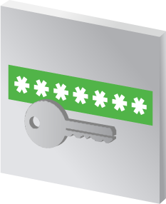
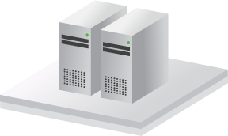




Dual Account Flows
No downtime to applications or servers. No need for a maintenance window.
Two deployment methods
Single account – One account credential is managed. Credential is rotated while application continues to run (while handling rotation in code).
Dual accounts – Two identical account credentials are managed: active and inactive. Application always uses the active account, while the inactive can safely be changed while application continues to run.
Dual account
Credential Provider
Server
Database
CyberArk Vault
Active
Credential
Inactive
Credential
50 days to credential rotation
40 days to credential rotation
30 days to credential rotation
20 days to credential rotation
10 days to credential rotation
5 days to credential rotation
Automatic credential rotation now
Newly Active credential is used
Notes:
<CLICK 1>
Let’s now see a demonstration of how the Dual Account deployment method works.
At all times, we have two accounts. One is tagged is “Active”, and the other is tagged as “Inactive”. These are the database are used to log onto the database on the left. This means that the same identical account needs to be preconfigured on the database.
These two accounts are currently already stored in the Credential Provider cache.
<CLICK 2>
When the application requests a credential the “Active” account is always the one that is returned.
Same as before, the organizational policy is to rotate credentials every 50 days.
Once this time comes, the “Inactive” account credentials will be rotated.
<Only once the green box says “Automatic credential rotation now” CLICK 3>
We’ve paused the application in order to elaborate on the fast process that takes place in the background, but in fact in real it keeps on going.
<CLICK 4>
The old “Inactive” credential is thrown away and is replaced by a new credential.
<CLICK 5>
Now, the tags are swapped around. The accounts that was tagged as “Active” is not “Inactive” and the accounts that was “Inactive” is now “Active”.
<CLICK 6>
From now on, the new “Active” credential will be used.
That’s it - the credential rotation is now complete.

Slide 29
Lab 4 - Continuous Authentication with dual accounts
Utilize Dual accounts for application up time
Change password while application is running
See new password in logs

Slide 30
Lab 5

Slide 31
Secretless Features
Open Source project https://secretless.io
Remove the need for developers to ever know secrets
Application is fully isolated from the secret, reducing the attack surface
Does not require code changes
Change the configuration, not the code.
Currently supported technologies
AWS-HTTPS & Basic Authentication for HTTP(S)
MSSQL, MySQL, & PostgreSQL Databases
SSH (BETA) & SSH Agent (BETA)
SDK Allows customers to build their own connectors
Notes:
<CLICK 1>
Let’s now see a demonstration of how the Dual Account deployment method works.
At all times, we have two accounts. One is tagged is “Active”, and the other is tagged as “Inactive”. These are the database are used to log onto the database on the left. This means that the same identical account needs to be preconfigured on the database.
These two accounts are currently already stored in the Credential Provider cache.
<CLICK 2>
When the application requests a credential the “Active” account is always the one that is returned.
Same as before, the organizational policy is to rotate credentials every 50 days.
Once this time comes, the “Inactive” account credentials will be rotated.
<Only once the green box says “Automatic credential rotation now” CLICK 3>
We’ve paused the application in order to elaborate on the fast process that takes place in the background, but in fact in real it keeps on going.
<CLICK 4>
The old “Inactive” credential is thrown away and is replaced by a new credential.
<CLICK 5>
Now, the tags are swapped around. The accounts that was tagged as “Active” is not “Inactive” and the accounts that was “Inactive” is now “Active”.
<CLICK 6>
From now on, the new “Active” credential will be used.
That’s it - the credential rotation is now complete.

Slide 32
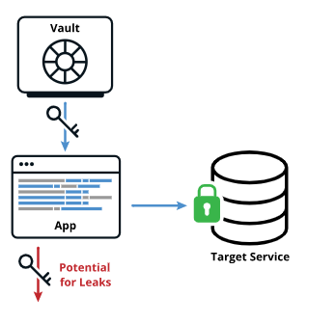
Traditional App Deployment
Notes:
<CLICK 1>
Let’s now see a demonstration of how the Dual Account deployment method works.
At all times, we have two accounts. One is tagged is “Active”, and the other is tagged as “Inactive”. These are the database are used to log onto the database on the left. This means that the same identical account needs to be preconfigured on the database.
These two accounts are currently already stored in the Credential Provider cache.
<CLICK 2>
When the application requests a credential the “Active” account is always the one that is returned.
Same as before, the organizational policy is to rotate credentials every 50 days.
Once this time comes, the “Inactive” account credentials will be rotated.
<Only once the green box says “Automatic credential rotation now” CLICK 3>
We’ve paused the application in order to elaborate on the fast process that takes place in the background, but in fact in real it keeps on going.
<CLICK 4>
The old “Inactive” credential is thrown away and is replaced by a new credential.
<CLICK 5>
Now, the tags are swapped around. The accounts that was tagged as “Active” is not “Inactive” and the accounts that was “Inactive” is now “Active”.
<CLICK 6>
From now on, the new “Active” credential will be used.
That’s it - the credential rotation is now complete.

Slide 33
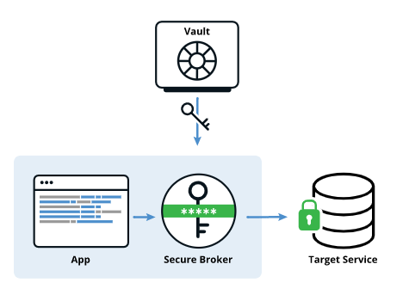
Secretless App Deployment
Notes:
<CLICK 1>
Let’s now see a demonstration of how the Dual Account deployment method works.
At all times, we have two accounts. One is tagged is “Active”, and the other is tagged as “Inactive”. These are the database are used to log onto the database on the left. This means that the same identical account needs to be preconfigured on the database.
These two accounts are currently already stored in the Credential Provider cache.
<CLICK 2>
When the application requests a credential the “Active” account is always the one that is returned.
Same as before, the organizational policy is to rotate credentials every 50 days.
Once this time comes, the “Inactive” account credentials will be rotated.
<Only once the green box says “Automatic credential rotation now” CLICK 3>
We’ve paused the application in order to elaborate on the fast process that takes place in the background, but in fact in real it keeps on going.
<CLICK 4>
The old “Inactive” credential is thrown away and is replaced by a new credential.
<CLICK 5>
Now, the tags are swapped around. The accounts that was tagged as “Active” is not “Inactive” and the accounts that was “Inactive” is now “Active”.
<CLICK 6>
From now on, the new “Active” credential will be used.
That’s it - the credential rotation is now complete.

Slide 34

Lab 5 - Secretless
Deploy secretless to connect to database after password change.

Slide 35
Thank You – Darren.khan@cyberark.com

